Slide 1
Wellcome To Ethical Hacking class 4th Week Day 2nd
Muhammad Bilal

Slide 2
Vulnerability Analysis
Common Vulnerability Databases
Common Vulnerability Scoring System (CVSS)
Vulnerability Management Practices
Vulnerability Analysis Tools
Nmap Scripting Engine (NSE) for Vulnerability Scanning

Slide 3
Common Vulnerability Databases
Overview:
Common vulnerability databases are centralized repositories that collect and provide information about security vulnerabilities in software and hardware systems. They serve as essential resources for organizations to identify, assess, and mitigate security risks.
Examples:
Common Vulnerabilities and Exposures (CVE): A widely used dictionary of publicly known information security vulnerabilities, maintained by the MITRE Corporation.
National Vulnerability Database (NVD):A comprehensive repository that supplements CVE entries with additional information such as severity scores, impact ratings, and mitigation advice.
Techniques:
Regular Monitoring: Continuously monitor vulnerability databases to stay updated on new vulnerabilities.
Integration with Tools: Integrate vulnerability database feeds with security tools to automate vulnerability detection and management.

Slide 4

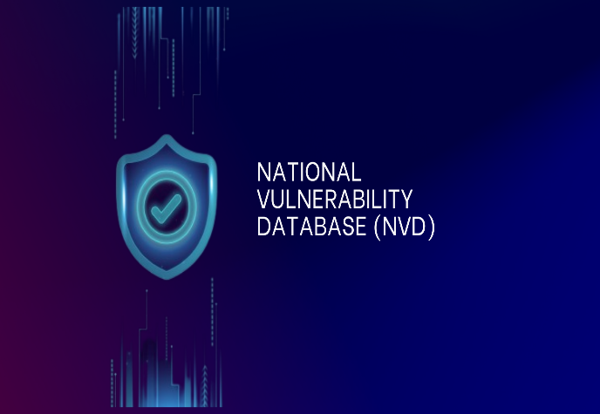
Common Vulnerability Databases
Tools/Websites:
CVE Details: A website that provides detailed information and statistics about CVEs.
NVD Website: Offers access to the National Vulnerability Database with search and filter capabilities.

Slide 5
Common Vulnerability Scoring System (CVSS)
Overview:
The Common Vulnerability Scoring System (CVSS) is a standardized framework used to assess the severity of security vulnerabilities. It provides a numerical score to help prioritize vulnerabilities based on their potential impact and exploitability.
Examples:
Example 1: A vulnerability with a CVSS score of 9.8, indicating a critical severity level due to easy exploitability and high impact on confidentiality, integrity, and availability.
Example 2: A vulnerability with a CVSS score of 4.0, representing a medium severity level with moderate impact and exploitability.
Techniques:
Vector Calculation: Use CVSS vectors to calculate scores based on factors like attack vector, complexity, privileges required, and impact.
Prioritization: Use CVSS scores to prioritize vulnerability remediation efforts, focusing on high-severity issues first.

Slide 6


Common Vulnerability Scoring System (CVSS)
Tools/Websites:
CVSS Calculator: Online tools that help calculate CVSS scores based on provided vectors.
FIRST CVSS Calculator: A tool by the Forum of Incident Response and Security Teams for computing CVSS scores.

Slide 7
Vulnerability Management Practices
Overview:
Vulnerability management practices involve a continuous process of identifying, assessing, prioritizing, and remediating security vulnerabilities to reduce risk and improve an organization's security posture.
Examples:
Example 1: Implementing a regular patch management process to ensure that software and systems are updated with the latest security patches.
Example 2:Conducting regular vulnerability scans and assessments to identify and remediate security weaknesses in the network and applications.
Techniques:
Asset Inventory: Maintain an up-to-date inventory of all hardware and software assets to identify where vulnerabilities may exist.
Risk Assessment: Evaluate the potential impact and likelihood of vulnerabilities to prioritize remediation efforts.

Slide 8
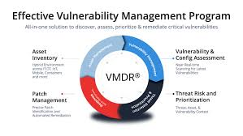

Vulnerability Management Practices
Tools/Websites:
Qualys Vulnerability Management: A cloud-based solution for identifying and addressing vulnerabilities.
Tenable.io: A comprehensive platform for vulnerability management and analysis.

Slide 9
Vulnerability Analysis Tools
Overview:
Vulnerability analysis tools are software applications used to detect, assess, and report on security vulnerabilities in systems, applications, and networks.
Examples:
Example 1: Nessus, a popular vulnerability scanner that identifies security issues across various platforms.
Example 2: OpenVAS, an open-source vulnerability scanner that provides comprehensive scanning capabilities.
Techniques :
Automated Scanning : Use tools to perform automated scans of systems and networks to identify vulnerabilities.
Manual Verification : Validate scan results manually to confirm the existence and impact of identified vulnerabilities.

Slide 10
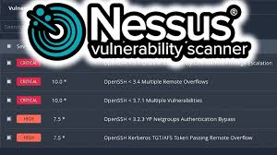

Vulnerability Analysis Tools
Tools/Websites:
Nessus: A widely-used commercial vulnerability scanning tool with extensive plugin support.
OpenVAS: An open-source vulnerability scanner that offers a wide range of scanning capabilities.

Slide 11
Nmap Scripting Engine (NSE) for Vulnerability Scanning
Overview:
The Nmap Scripting Engine (NSE) is a powerful feature of the Nmap network scanning tool that allows users to write and execute custom scripts to automate network discovery and vulnerability scanning tasks.
Examples:
Example 1: Using an NSE script to check for the Heartbleed vulnerability on SSL/TLS-enabled servers.
Example 2: Employing an NSE script to detect and report on open ports and services running on a network.
Techniques:
Script Selection: Choose appropriate NSE scripts from the Nmap library or write custom scripts to address specific scanning needs.
Target Specification: Use Nmap’s targeting options to specify hosts and networks for scanning with NSE scripts.

Slide 12

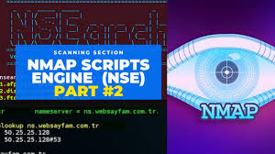
Nmap Scripting Engine (NSE) for Vulnerability Scanning
Tools/Websites:
Nmap: The official Nmap website provides access to the tool and documentation for NSE scripting.
GitHub - Nmap NSE Scripts: A repository of NSE scripts that can be used for various vulnerability scanning tasks.

Slide 13
Thank You Happy Hacking

